Slide 1
#Genre Predictor from Lyrics
Team: Kunal Chugh, Rohan Jahagirdar
GithuB
Team 2

Slide 2
Use Cases
As a user, if I enter a previously unknown lyrics into the application, it should return the probability of it belonging to different genres.
As a user, if I enter a previously unknown lyrics into the application, it should return top 5 most probable artists for the lyrics.
As a user, if I enter a previously unknown lyrics into the application, it should return 3 similar songs based on the following features extracted from the lyrics:
Reading levels
Artist
Rhyming scheme
Key combination of words
tf-idf

Slide 3
Methodology
Dataset Transform
Ingest Raw Data
Data cleaning
Stop word removal
Tokenize lyrics
Parent word identification
Feature Extraction
Rhyme Scheme
Readability score of lyrics
N-gram for key combination of words
Most Frequent words by Artist
Most Frequent words by Genre
ML algorithm using MLlib
Prediction
Word Vectorization
Clustering
Genre
Artist
Similar songs
NLP
Regression

Slide 4
Data source
400000 song lyrics
kaggle 380000 songs dataset
kaggle 55000 songs dataset
Song additional features from Spotify:
Details of album and genre
For missing data fetch it from Spotify and Musixmatch APIs

Slide 5
Milestones
Task | Sprint Start | Sprint End
Data Transformation, Unit Testing and Integration Testing for TDD | 15 March 2018 | 24 March 2018
Feature Extraction with Testing | 25 March 2018 | 31 March 2018
MLlib algorithms for different models and validation with Testing | 1 April 2018 | 07 April 2018
Prediction: genre, artist | 08 April 2018 | 14 April 2018
Prediction of similar songs and final corrections with all Tests | 14 April 2018 | 24 April 2018

Slide 6
Programming in Scala
Data Ingestion
Data cleaning
Feature Extraction using Scala and Spark
Spark MLlib

Slide 7
Acceptance Criteria
Minimum of 65% success rate for predicting genre within 3-5 seconds
Top 5 probable artists for the given lyrics
If the artist is present in the dataset, should be in the top 5 probable artists list
Predict up to 10 similar songs with a prediction time of 5-8 second

Slide 8
Goals
Correct prediction of genre of a song from a lyric
Providing a prediction for probable artists for the song
Predict similar songs from the dataset
Meet all project deadlines
Follow TDD
Have code coverage for the maximum part if not entire source code
Learn and follow good software development practices
Collaborate and share knowledge with team member
Learn and follow peer coding standards and code review and integration standards.

Slide 9
Resources
Spotify API: for features
Kaggle: for dataset
ReadabilityMetrics: for reading level of words/sentences
Rhyming Scheme

Slide 10
Final Presentation
Data Transform
Completed Tasks:
Data Ingestion
Data Cleaning
Stop Words Removed
Tokenization

Slide 11
Feature Extraction
Completed Tasks:
Most Frequent Words by Artists
Most Frequent Words by Genre
Readability Score
Rhyming Scheme
Top Frequent words in Song

Slide 12
MLlib
Completed Tasks:
Implemented Regression-LogisticRegression
Word2Vec Model
Pipelining
HashingTF
FeatureHasher
Vector Assembler

Slide 13
Prediction
Completed Tasks:
Genre
Probable Artist

Slide 14
Pipelines
Cross Validator Model
Word2Vec Model

Slide 15
Cross Validator Model
Ingest Raw Data
Data cleaning
Tokenize
Stop Word Removal
Rhyming Scheme
Readability Score
Top Words
Feature Hasher
HashingTF
Vector Assembler
Logistic Regression

Slide 16
Word2VecModel
Ingest Raw Data
Data cleaning
Tokenize
Stop Word Removal
Genre Grouping
Word2Vec
Word2Vec Model
Cosine Similarity of Word to Genre
Word Vector To All Words

Slide 17
Use Case Example– Predicting Genre
75% accuracy - 9 out of 12 song genre’s predicted correctly

Slide 18
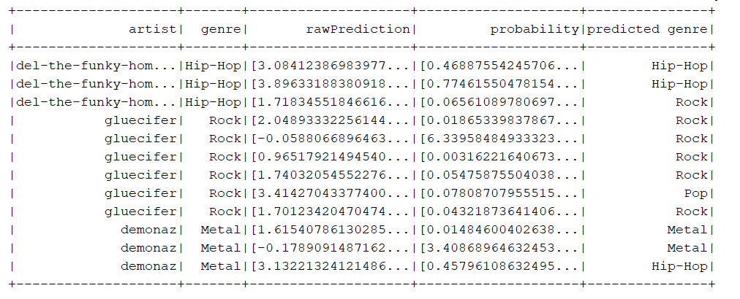
Use Case Example – Predicting Genre
9 out of 12 song genre’s predicted correctly giving 75% accuracy

Slide 19
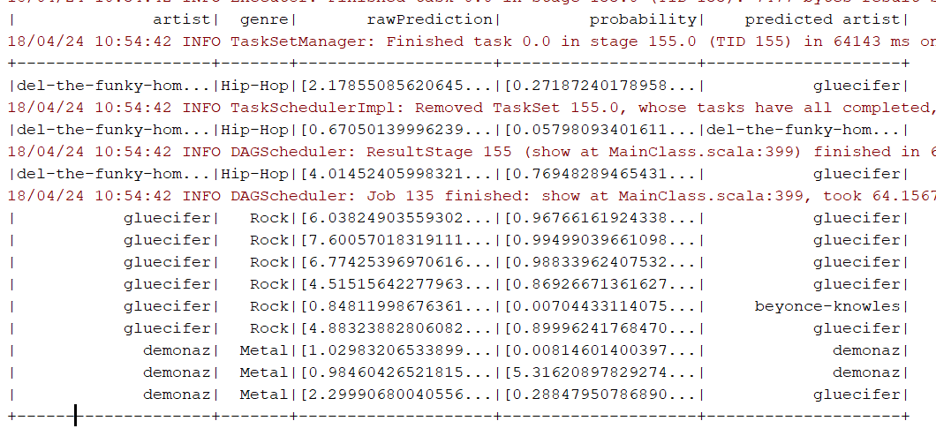
Use Case Example – Predicting Artist
8 out of 12 song artist’s predicted correctly giving 67% accuracy

Slide 20
THANK YOU!

